Slide 1
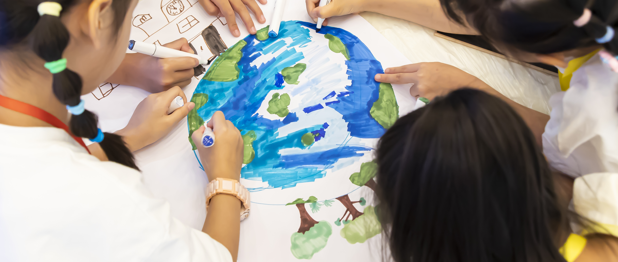


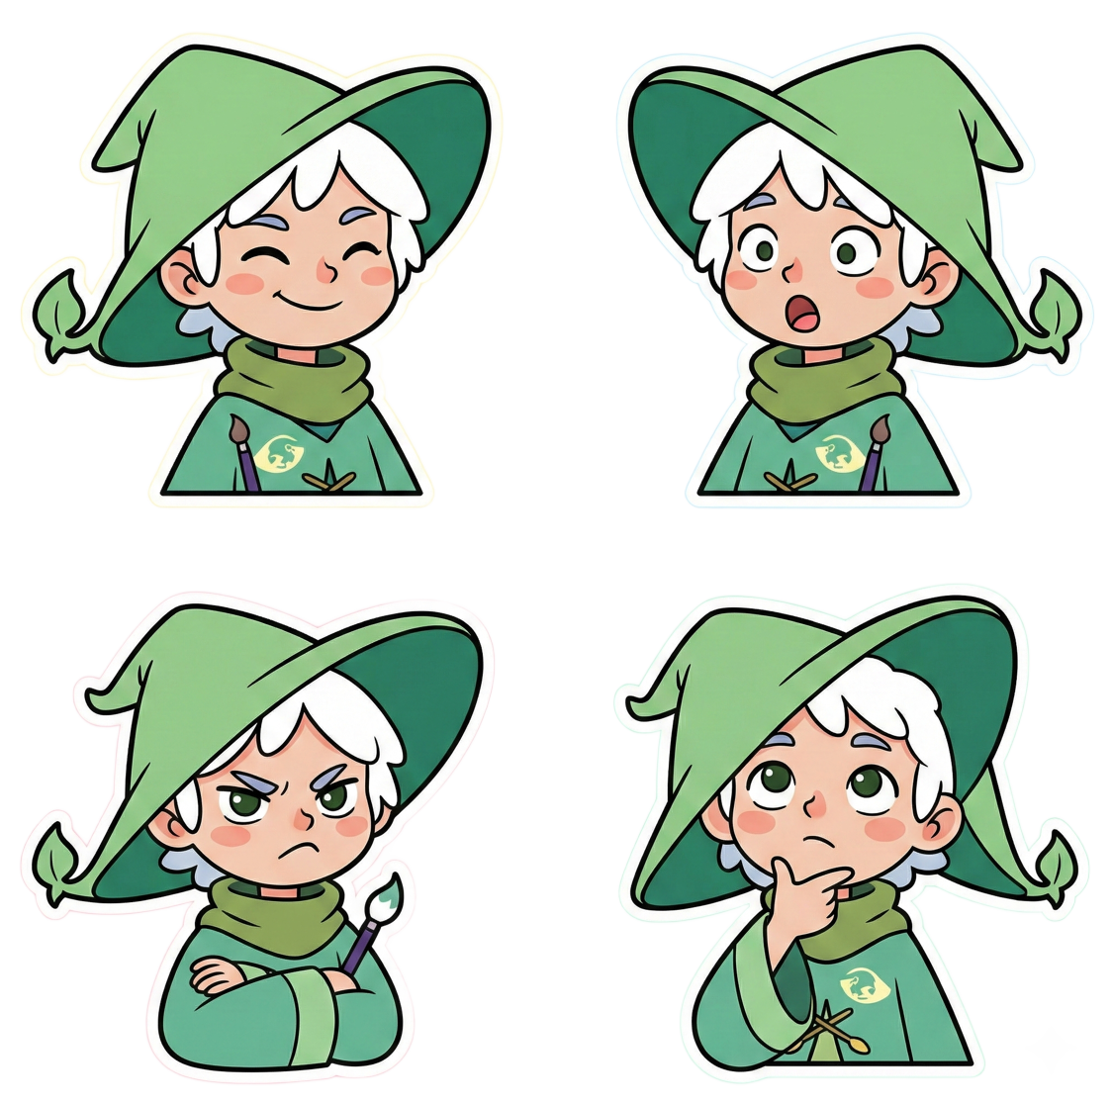

Power of Games | For a Sustainable Future
Game Co-creation Workshop
Special Guest:
This presentation is for non-profit educational use only. Any commercial or illegal use is strictly prohibited.

Slide 2
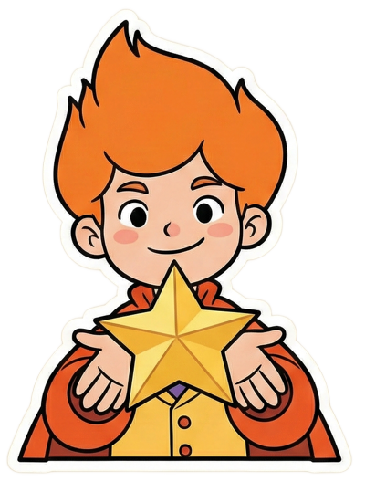

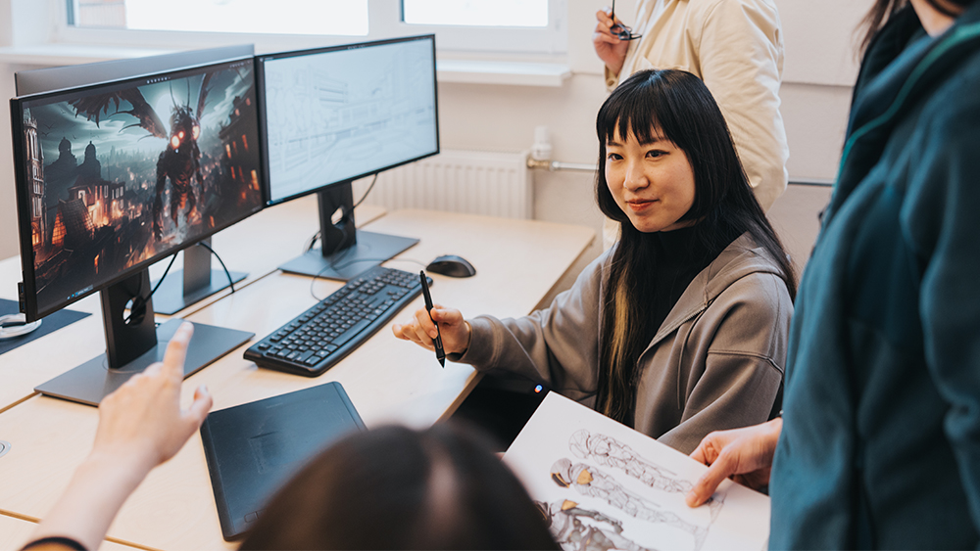
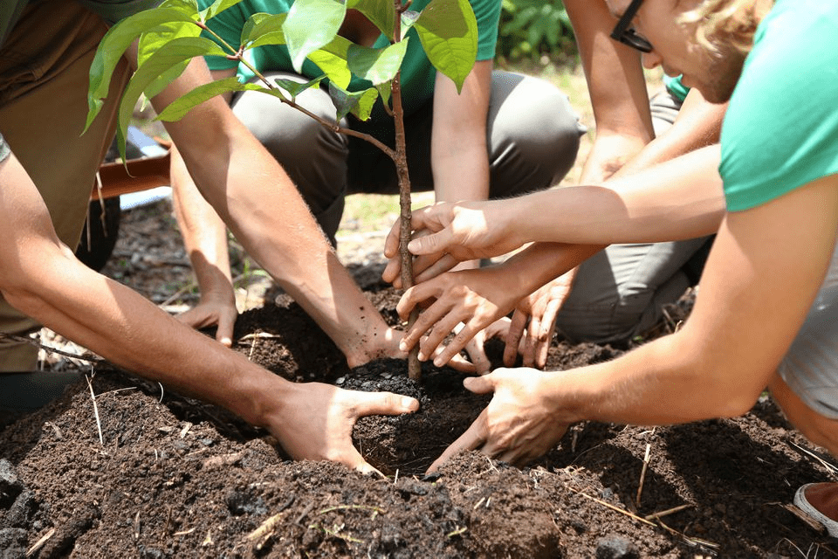

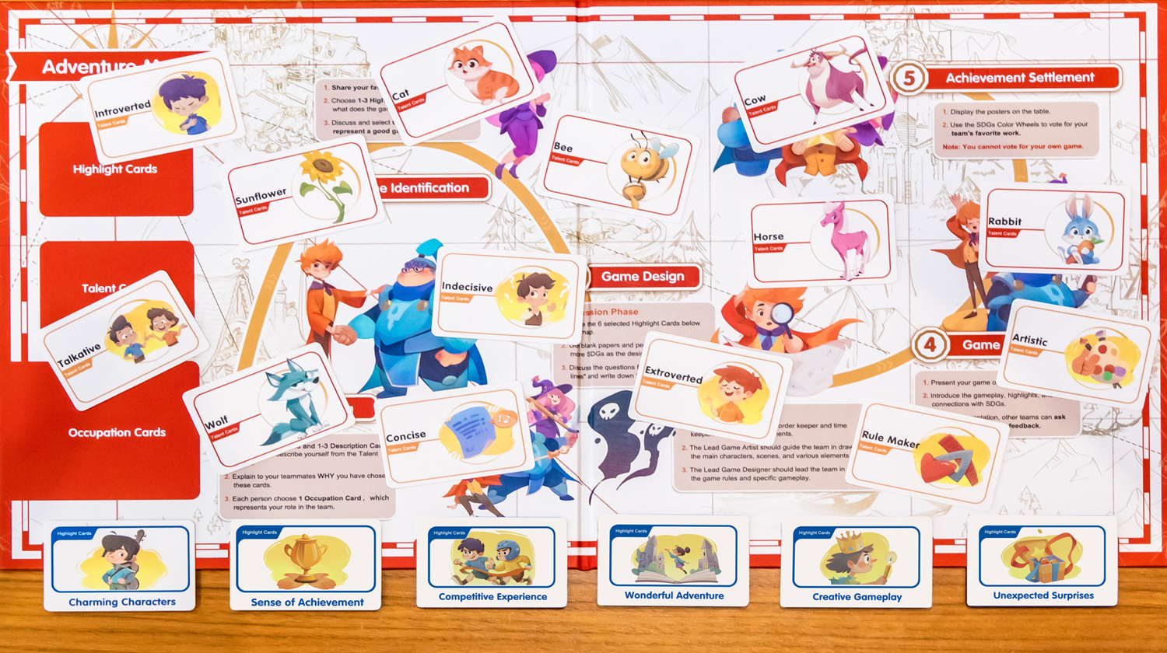
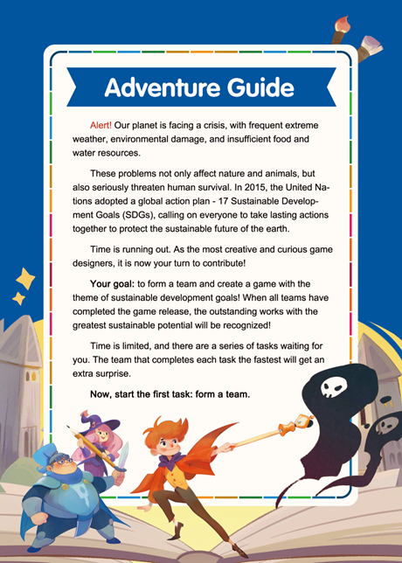



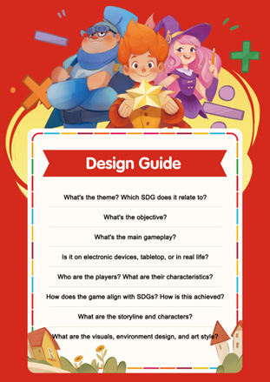
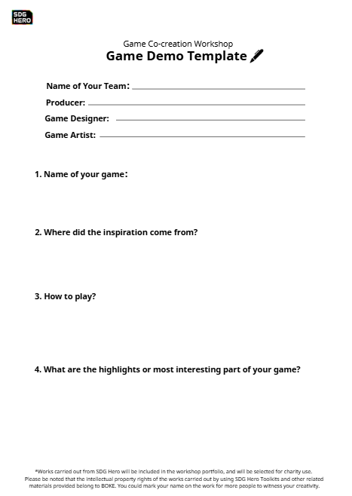
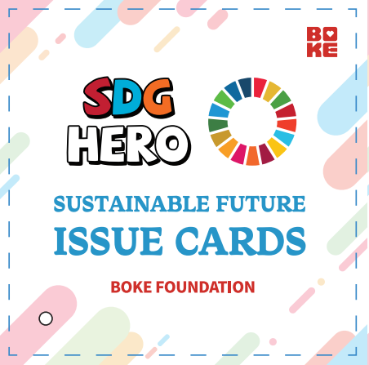
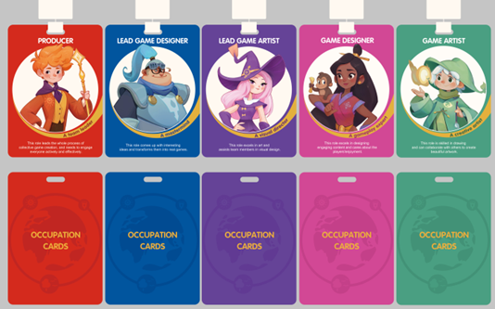

Workshop Roadmap
🚩1.Equip Knowledge
Learn about Sustainable Development Goals (SDGs) & game design basics.
🚩2. Form a Design Team
Your team will create and present a game based on a specific SDG theme.
🚩3. Adventure Settlement
Expand your understanding about SDGs
in future learning and take actions.
Toolbox

Slide 3
We invite you to
complete five tasks:
Design your very own game!
Hi👋 young heroes! Let's use the power of games to create a sustainable future!

Slide 4



Today's game design themes come from
the 17 Sustainable Development Goals published by the United Nations！

Slide 5
What are the (SDGs)
Sustainable Development Goals?
Notes:
2030年可持续发展议程
响应2030年可持续发展议程

Slide 6






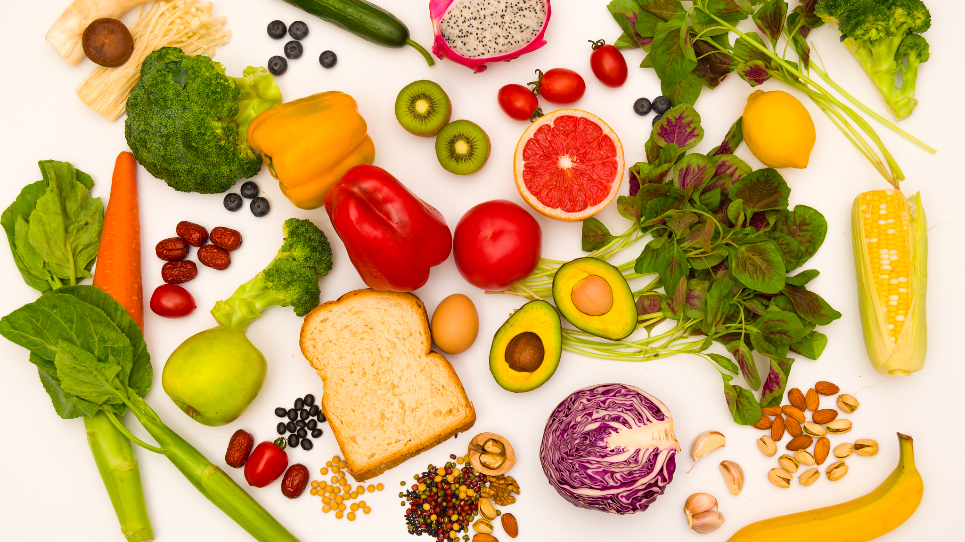


Notes:
全世界仍有超过 35 亿人无法获得基本的卫生保健服务。

Slide 7
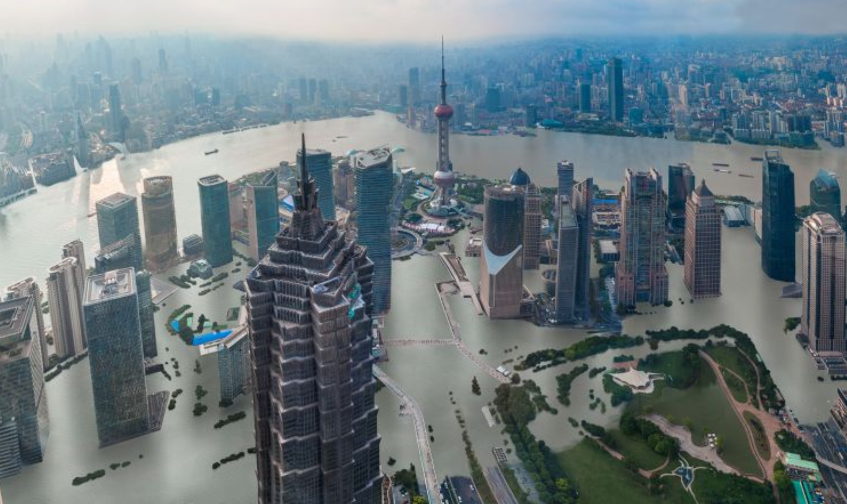
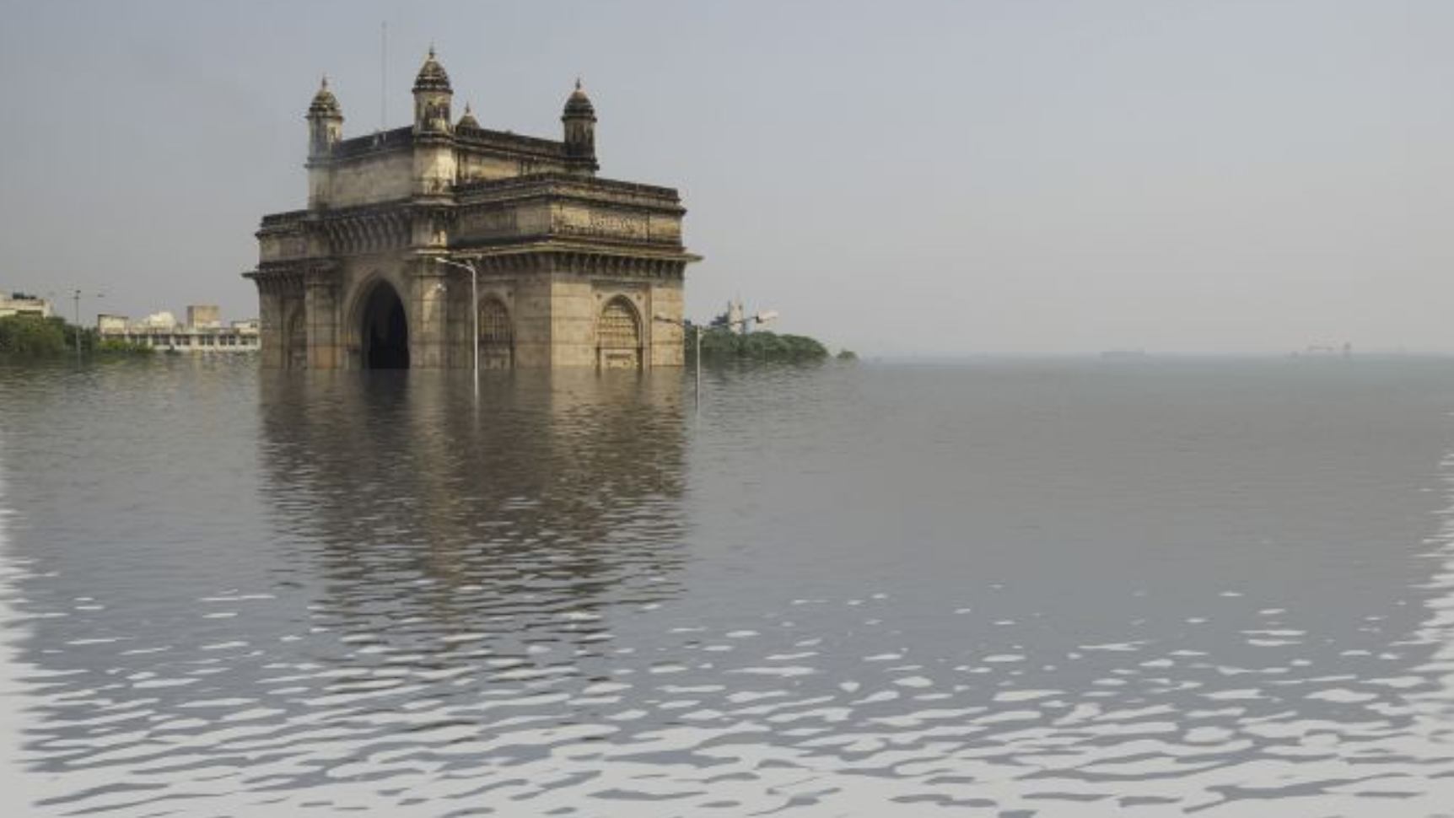



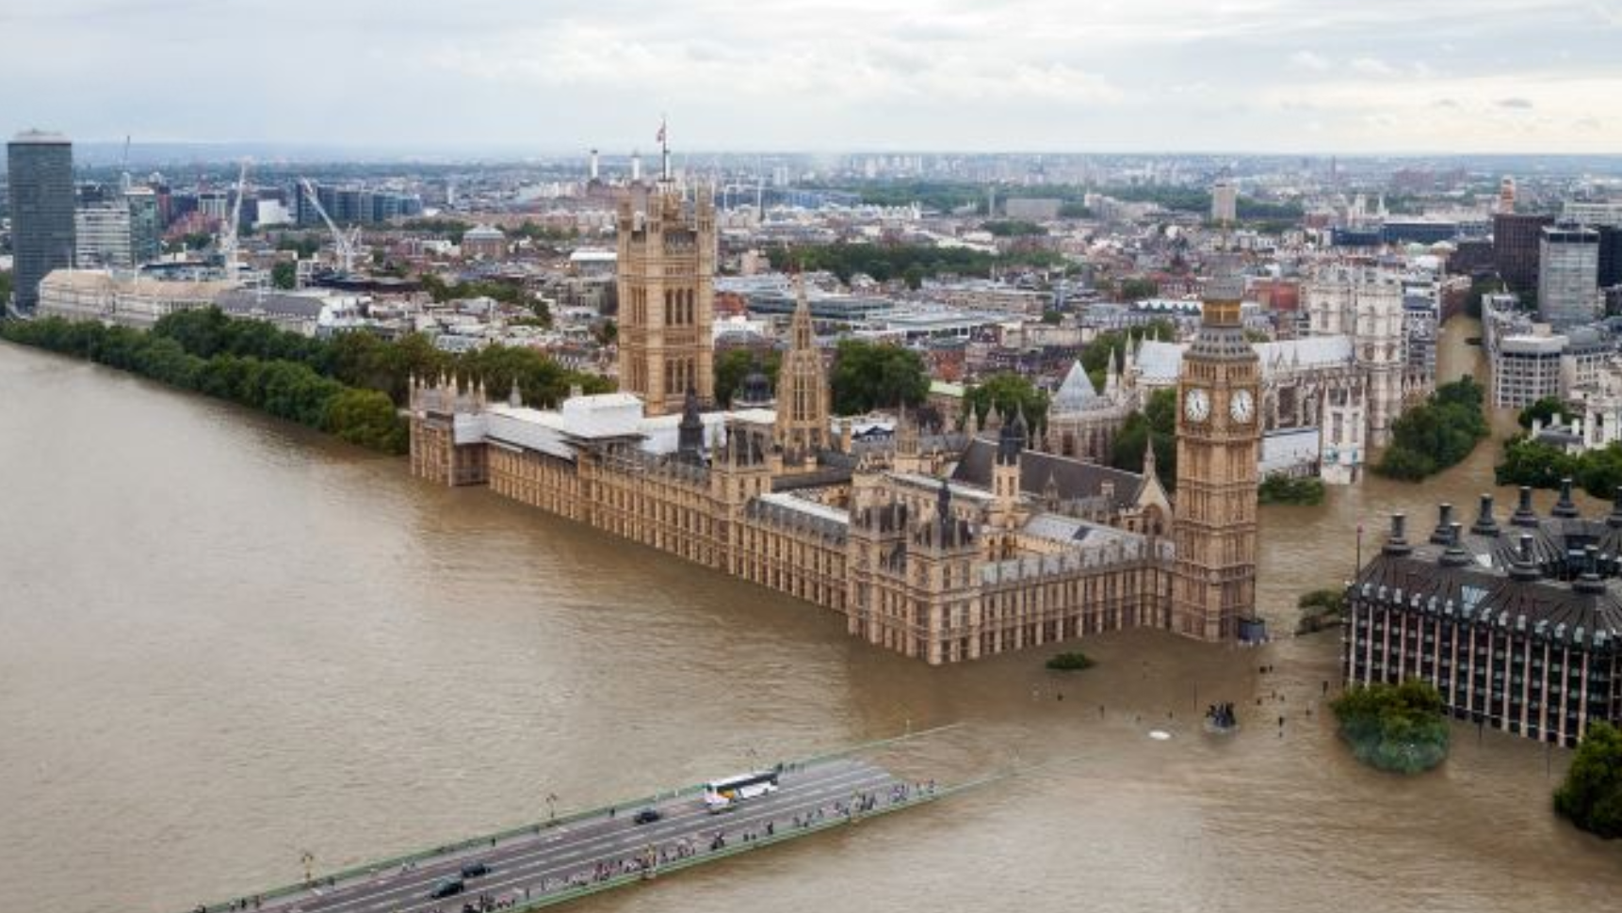
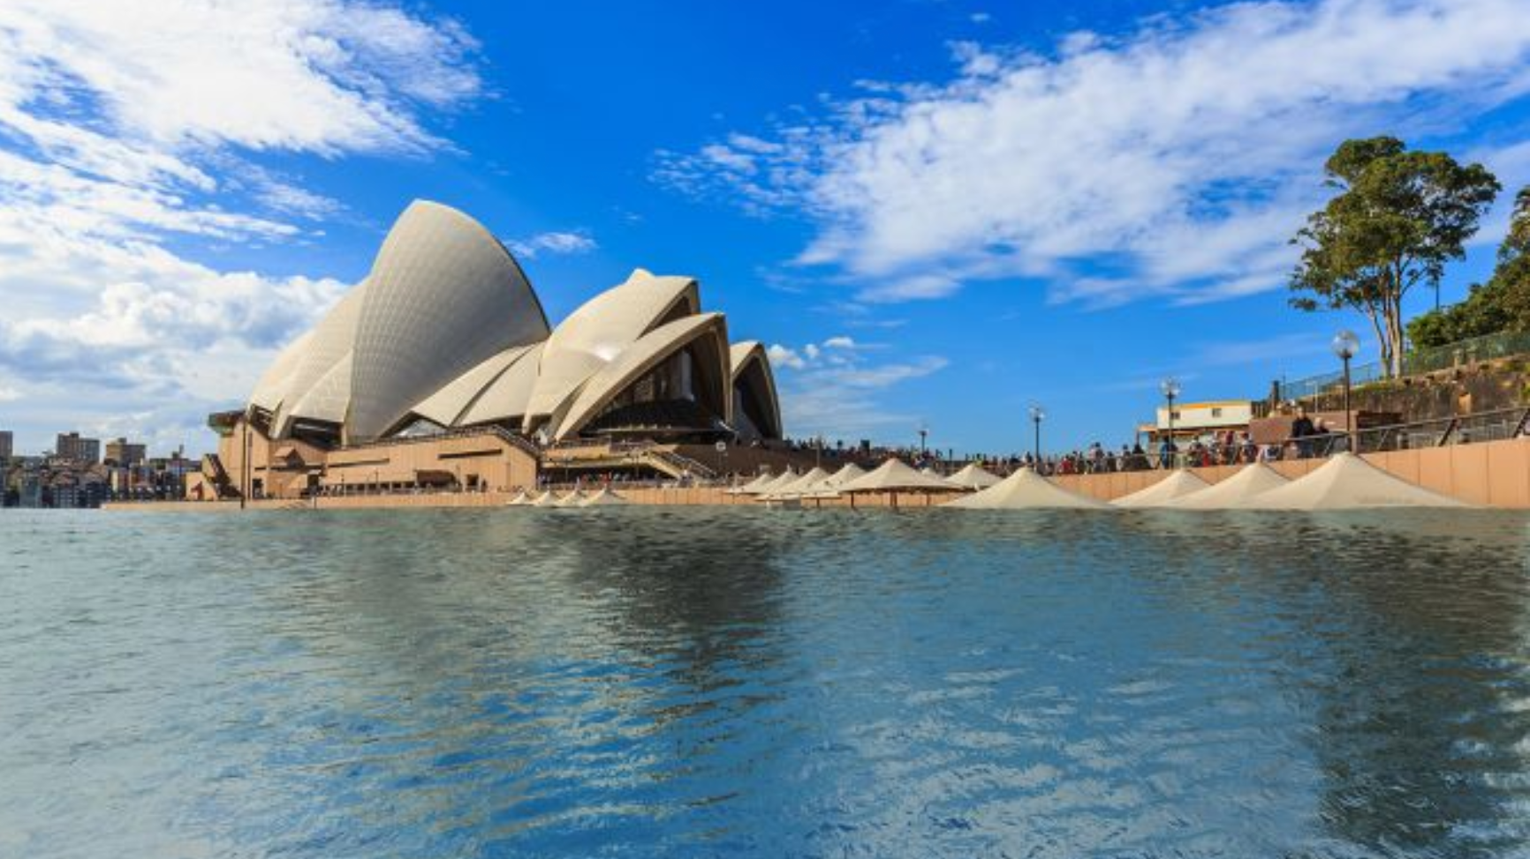


Global temperature rises by 4 °C
Notes:
全球气温上升4摄氏度后，中国上海遭海水淹没模拟题（图片来源：Climate
Central网站）
全球气温上升4摄氏度后，中国上海遭海水淹没模拟题（图片来源：Climate
Central网站）

Slide 8
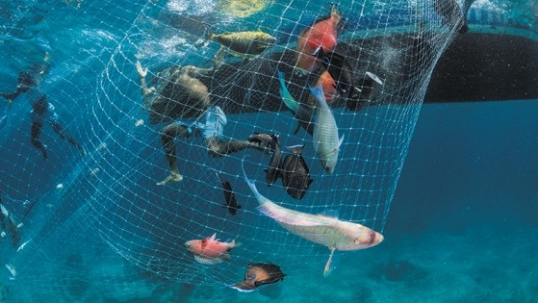
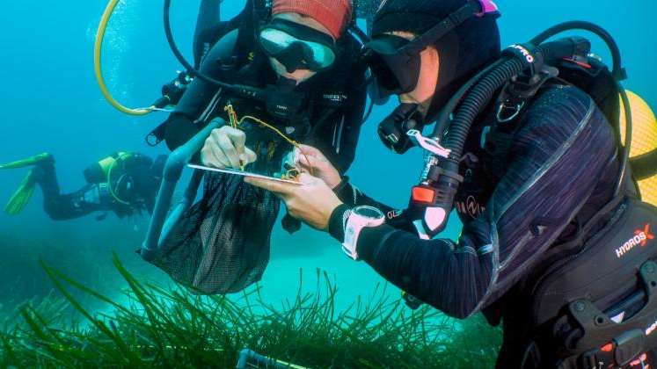

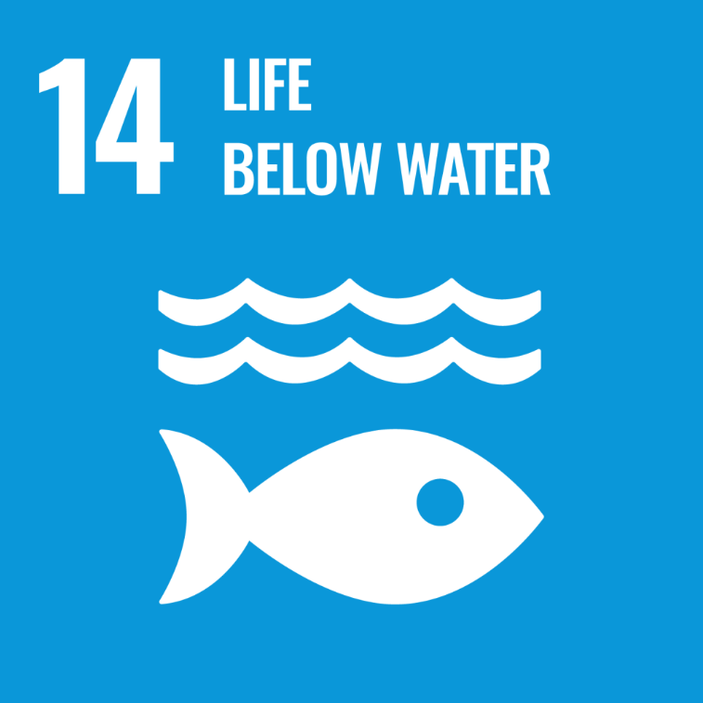

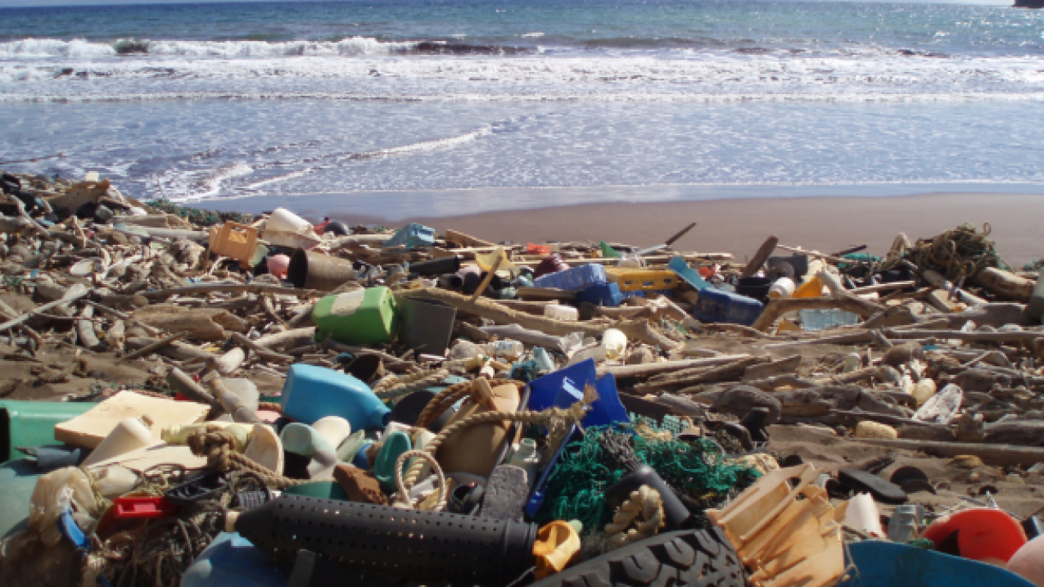
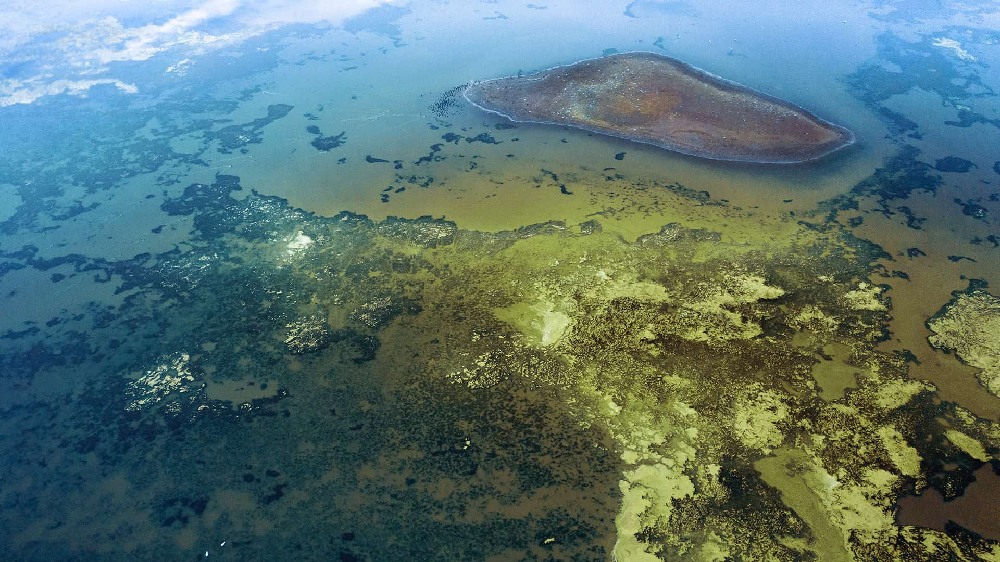


Notes:
打击非法，未报告和无管制的捕捞活动，海洋污染，增加海洋健康的科学知识，研究和技术，海洋酸化

Slide 9
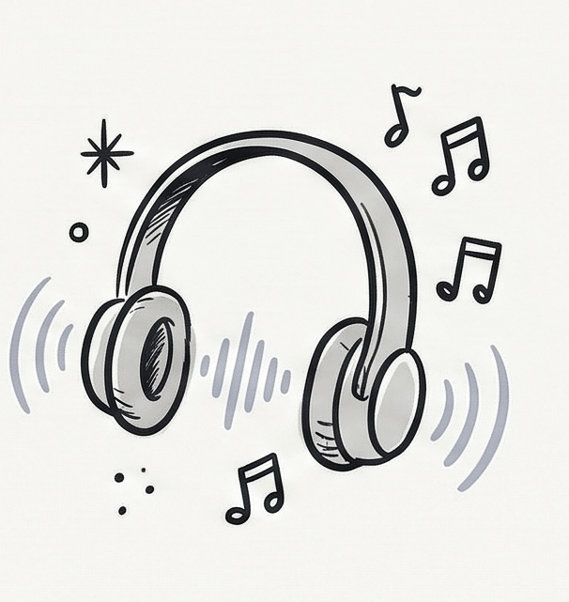
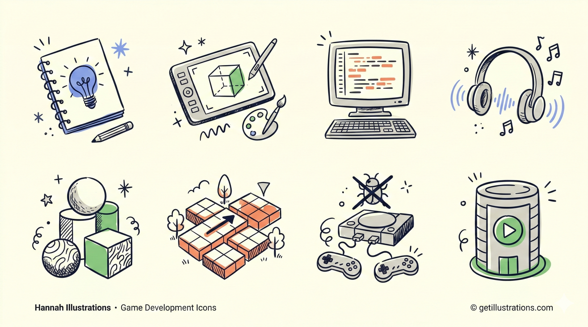
Who makes games?

Slide 10
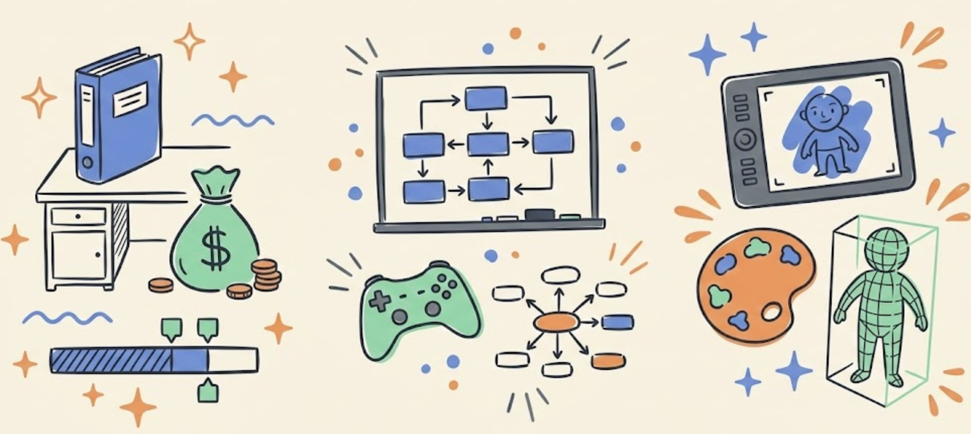
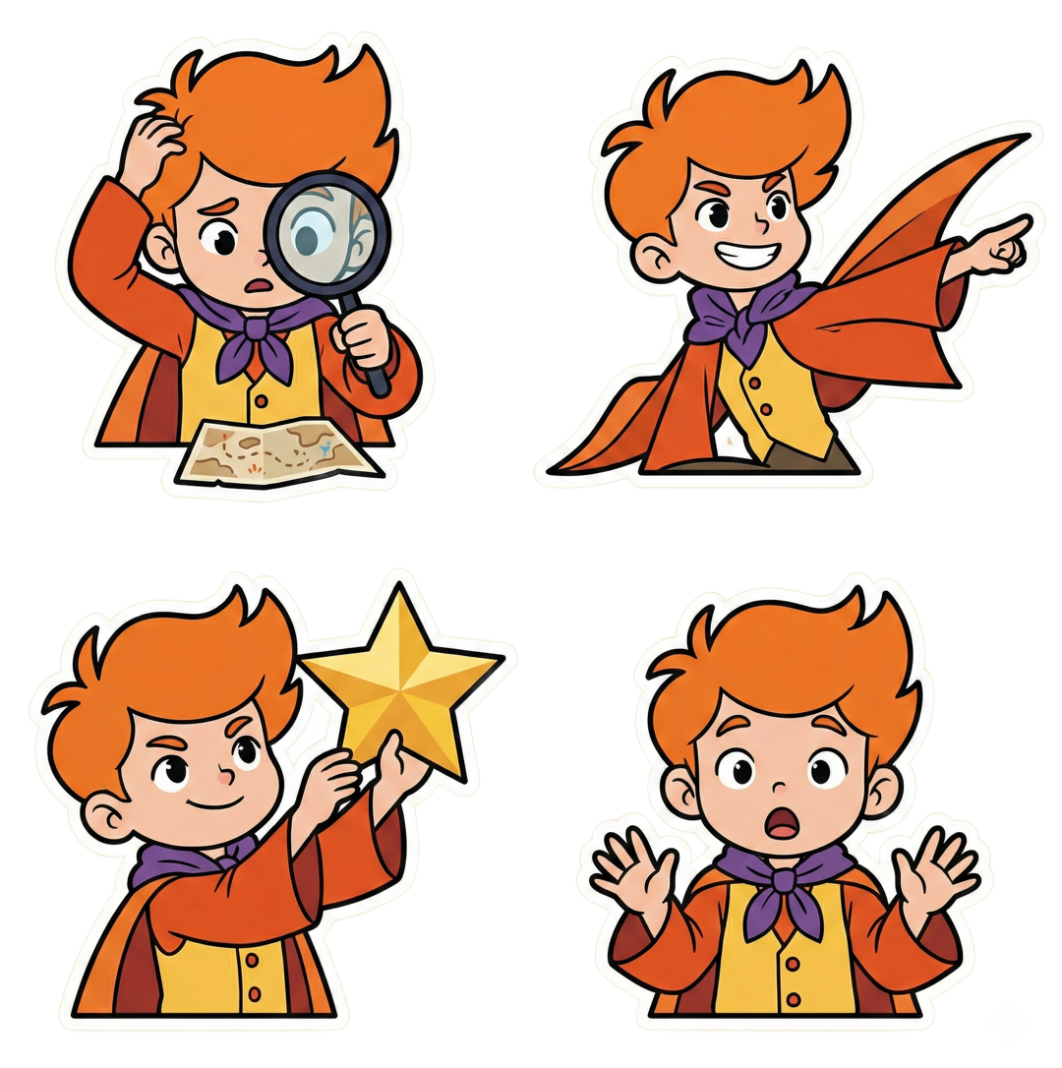
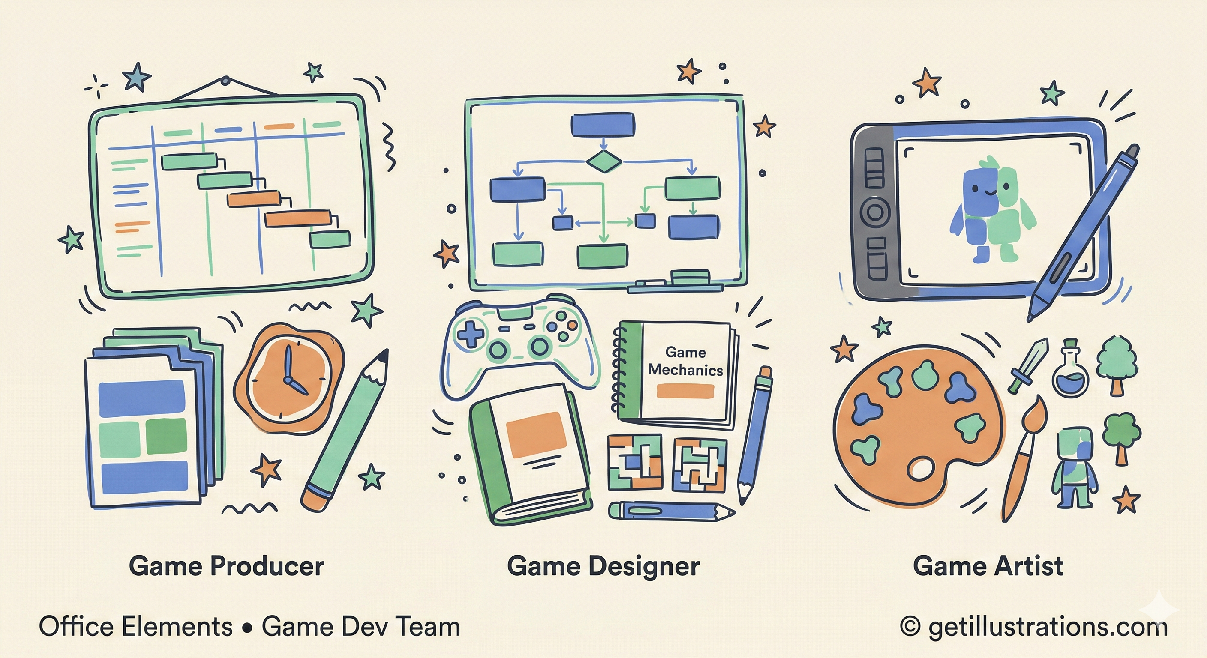
Game Producer
🚩The person who manages project progress
and takes the lead in making decisions.
🚩The backbone of the team, responsible for
coordinating and organizing resources.

Slide 11
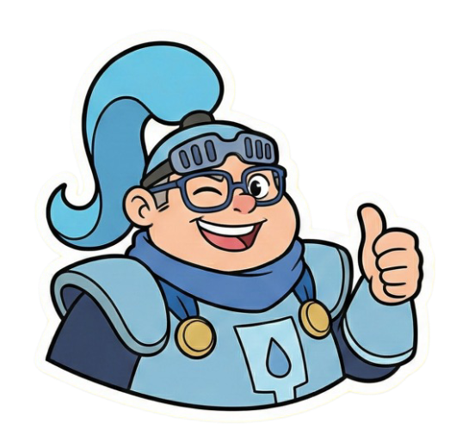
Game Designer
🚩The person who turns game ideas into specific
details and shares them with the team.
🚩The person most likely to be blamed by players!

Slide 12
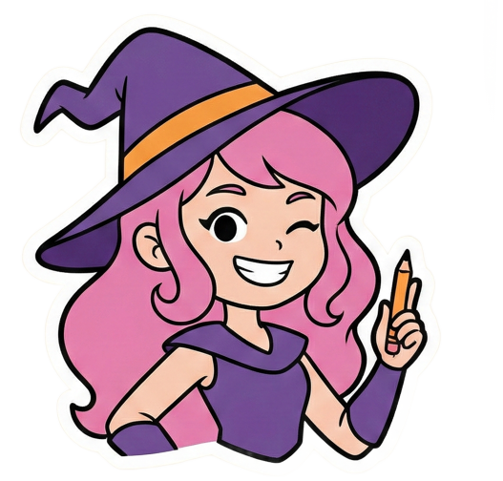
Game Artist
🚩The person who decides the game's aesthetic,
drawing imaginations and designing visuals.
🚩The person who often argues with the Game
Designer!

Slide 13
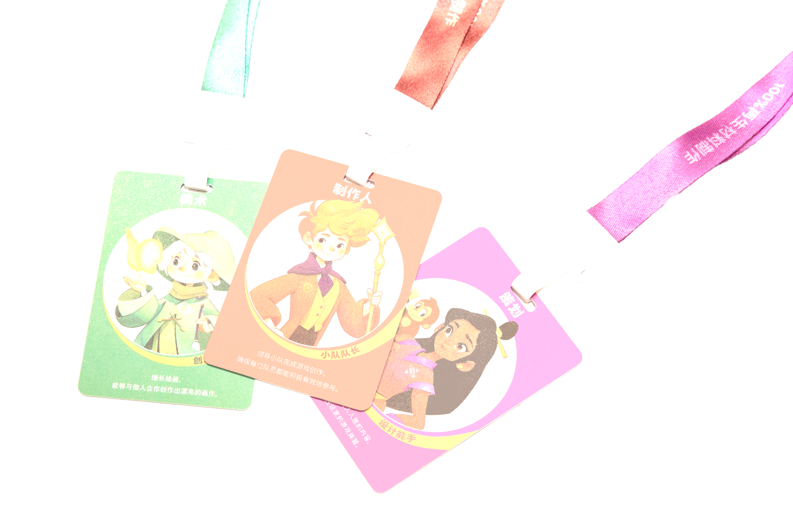
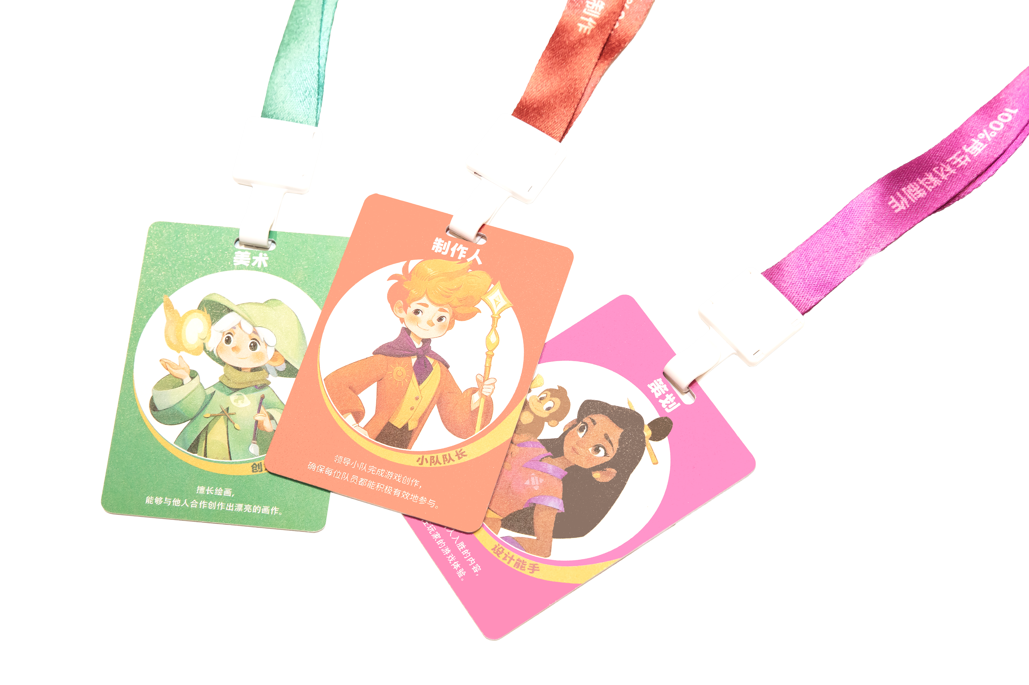
Team Roles
Each Team needs at least one Producer (Team Leader), one Lead Designer (Core Gameplay), and one Lead Artist (Visual Design).
Producer
Designer
Artist
Serves the team &
manages progress
Guides gameplay & game story
Guides visual &
Artistic expression
🏠
Programmer (Writes game running logic)
Creating a good game is like a dream factory.
When all the gears turn together, the miracles happen!
🕵️‍
Tester (Checks game quality)
🚀
Operator (Creates game events)

Slide 14
Task 1:
Share Your Talents
Everyone, Get to know each other
and create a mini game design team!

Slide 15
Team Forming
Time limit: 5 minutes
🚩Select and share 1 Animal Card and 2 Description
Cards that can best describe yourself.
Key Items
🚩Choose 1 Occupation Card that suits you.
🚩Give your Team a creative name (and write it on
the Game Demo Template).

Slide 16
Task 2：
Game Identification
Games always bring us joy. Let‘s discuss
the highlights of different game types!

Slide 17
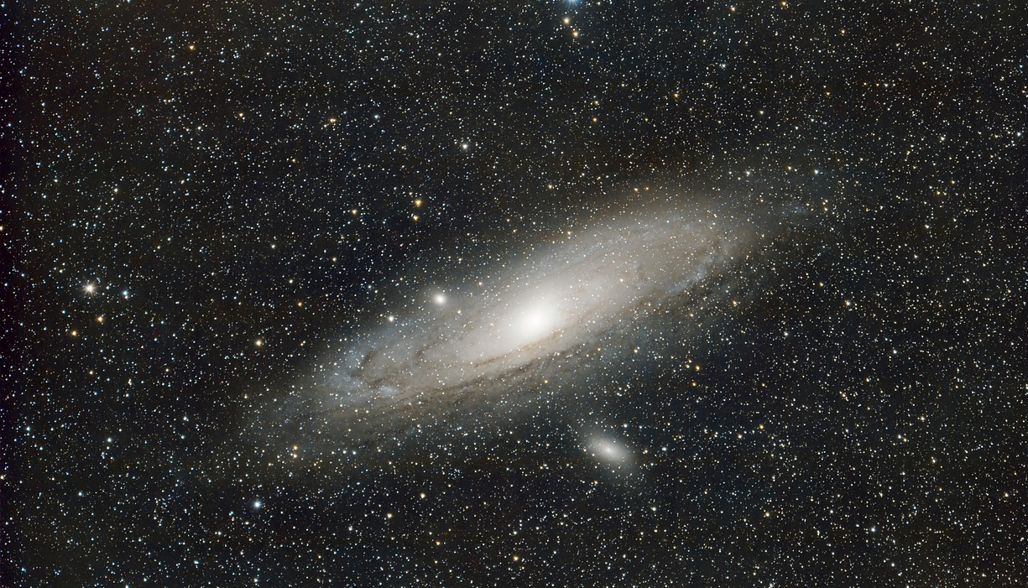

The Game Universe
Anything can be a game
Life Planet
Examples：
Tabletop Planet
Monopoly
Card games/Poker
Examples：
Olympic Games
Role-playing
Hide and seek
Examples：
Screen Planet
Mobile games
PC games
Examples：
Creation Planet
Paper airplanes
Building blocks

Slide 18
Common Game Standards
Game = 🎯Goal + 📜 Rules + 🤪Fun Challenges
01
Completeness
Is there at least one experience ?
How many players？
Digital? Outdoors?
How to play?
How does it end?
02
Fun Factor
Is it fun to play?
03
Aesthetics
Any appealing characters or scenes?
04
Functionality
Any value beyond entertainment?

Slide 19
Game Highlights
Time limit: 10 minutes
🚩Share one of your favorite games:
Why do you like it? What are its characteristics?
Key Items
🚩Pick 1-3 Highlight Cards that attract you.
🚩Each team keep 6 Highlight Cards and place
them below the map.

Slide 20

Task 3：
Game Co-creation
The game design theme today is:
SDG 3 Good Health and Well-being

Slide 21

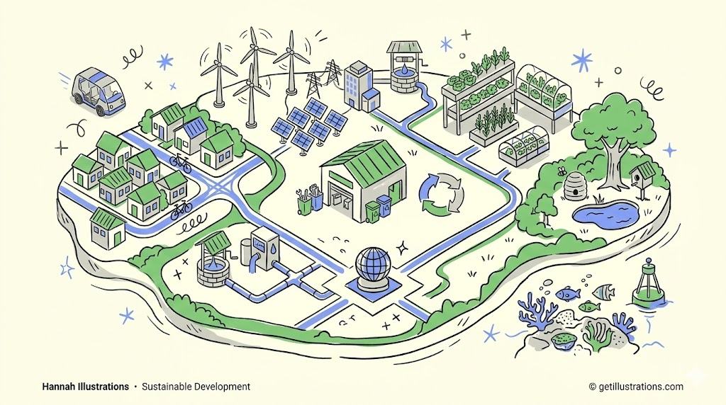

Ensure everyone (from infants to seniors)
can live a healthy life.
Our Goal:
Max out the "Health Bar" for all of humanity!
“Health is a fundamental human right.”
Three Lines of Defense:
Survival: Reduce maternal and infant mortality rates.
Defense: End infectious diseases and fight sudden outbreaks.
Action Guide：
Share the importance of health with family and friends.
Break the stigma against mental health and all kinds of illness.
Get enough sleep and maintain a regular routine.
SDG 3
50%
of the world's population still lacks access to basic healthcare services.
Why does this matter to us?
Mental Resilience: Learning how to manage emotions and stay calm under academic pressure.

Slide 22
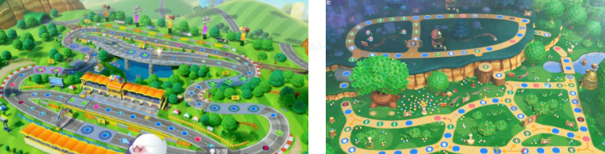
Game Example
Defeat the Leukemia Demon
Player： Children undergoing rehabilitation challenges.
Rules：
Roll the dice on the world map, challenge "Low-Fat Diet Island", "Hygiene Diet Island", and "Low-Residue Diet Island".
Swipe or tap the screen to catch healthy food and eliminate bacteria and high-fat monsters.
Answer random diet quizzes to earn points and avoid traps.
Goal：Defeat monsters, pass levels, and collect "Recovery Medals".
Highlight： It turns boring dietary restrictions into an action game for learning rehabilitation diets.

Slide 23
Game Design
Time limit: 40 minutes
🚩10 mins to discuss game goal & gameplay
🚩30 mins to perfect rules & visuals
Design Topic
Write it down
Draw it out
Inspired by a SDG theme, design a game prototype and its poster.
Game Name
Game Goal
Game Rules
Game Highlights
Game Visual Style: Map, characters...
Poster:
Scenes, key elements…

Slide 24
Task 4:
Game Release
Investors in the audience, ready? Welcome each team's brilliant work with a round of applause!

Slide 25
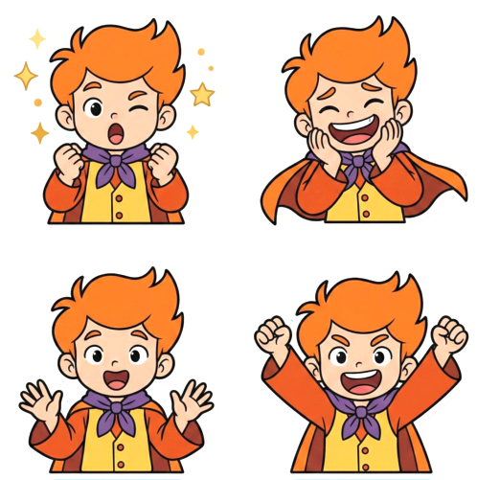
Core Gameplay:
-Who is the player?
-How to play?
-How to win?
Core Concept:
-Game Name
-Source of Inspiration
-Story Setting
3 Minutes
Ultimate Pitch
Highlight Experience:
-What’s fun?
-What is the most rewarding moment in this game?
-How it responds to SDGs?

Slide 26
Task 5:
Achievement Settlement
The adventure is coming to an end. Using Color Wheels to vote for your favorite work!
Note: You cannot vote for your own team.

Slide 27
🚩How did you feel during the process of
co-designing the game?
🚩What new understanding do you have
about the SDGs?
🚩Back in your daily life, what kind of
sustainable actions would you like to try?

Slide 28
Let's take a group photo
with today's creative works!
We hope you can become a
Super Player in the game of life,
and take actions driving a Sustainable Future!

